Slide 1

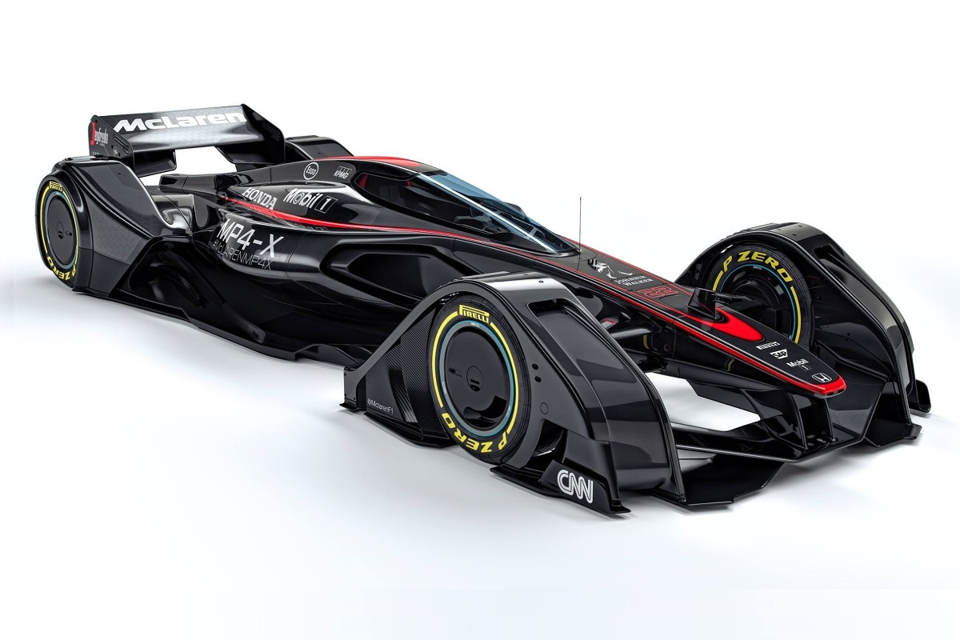

SolidWorks Essentials Basics to Advanced Techniques
Presented by
GOUSHIK RAM R
CAD ENGINEER

Slide 2

About Us:
We started our journey in the year of 2000
Provides Training & Engineering solutions to industry professionals & students.
So far trained more than 100000 student.
Solution provided in design, industrial engineering, intelligent manufacturing & digital prototyping.

Slide 3
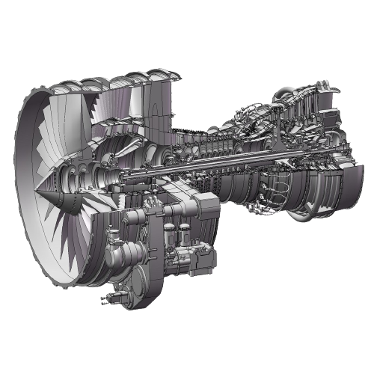
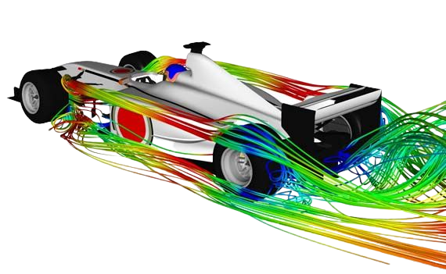
TABLE OF CONTENT
CAD, CAM , CAE.
INTRODUCTION OF SOLIDWORKS
SPECIFICATION OF SOLIDWORKS
SPECIALIZATION AND ADVANCED TECHNIQUES OF SOLIDWORK
INDUSTRIAL APPLICATION
TOP COMPANIES USING SOLIDWORKS

Slide 4
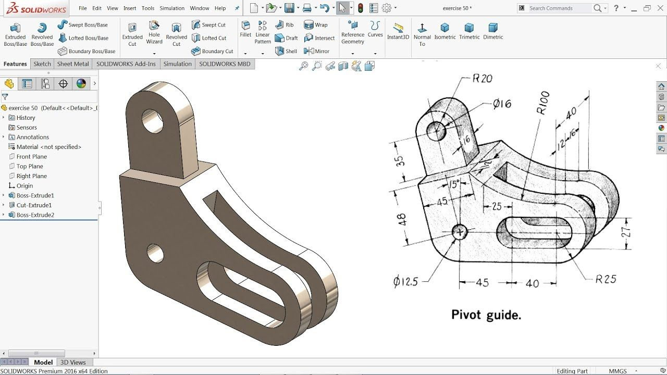
CAD (Computer Aided Design):
CAD software is frequently used by different types of engineers and designers. CAD software can be used to create two-dimensional (2-D) drawings or three-dimensional (3-D) models.
CAD software is widely used by professionals in various industries to produce precise and detailed drawings, 2D and 3D models, and simulations.

Slide 5
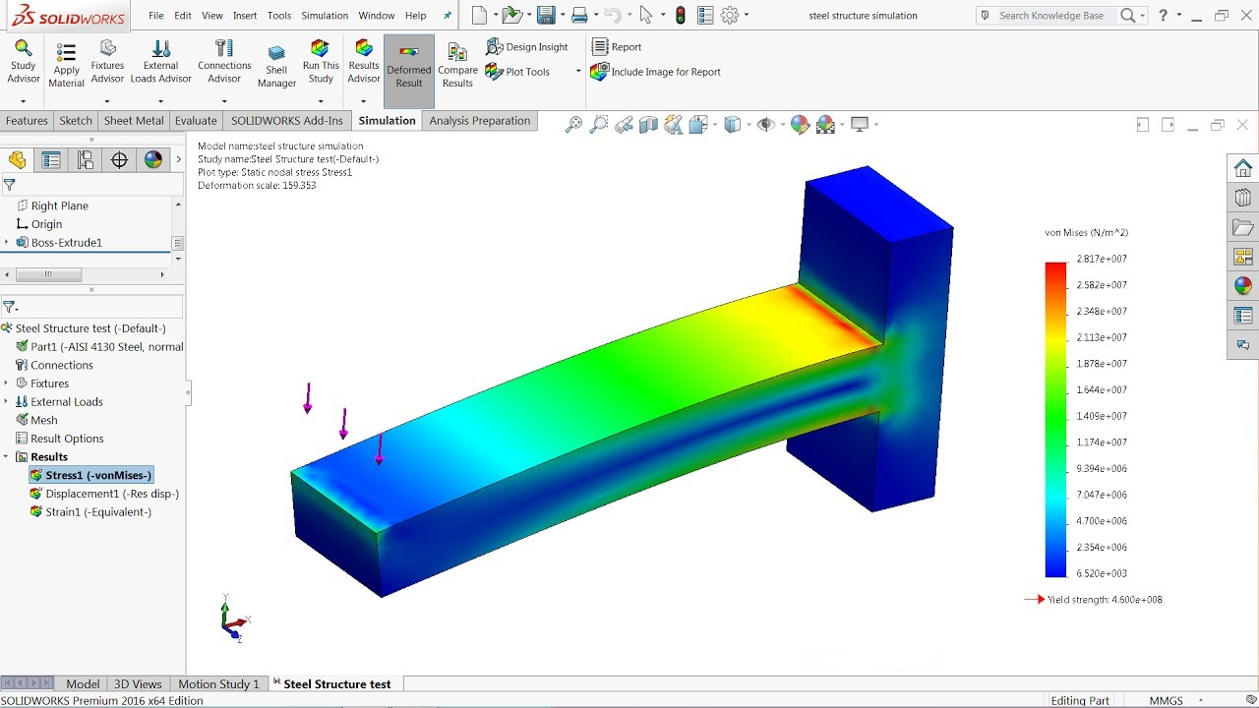
CAE (Computer Aided Engineering):
Computer-aided engineering (CAE) is the use of computer software to simulate performance in order to improve product designs or assist in the resolution of engineering problems for a wide range of industries.
Stress and dynamics analysis on components and assemblies using finite element analysis (FEA)
Thermal and fluid analysis using computational fluid dynamics (CFD)
Kinematics and dynamic analysis of mechanisms or Motion analysis.

Slide 6
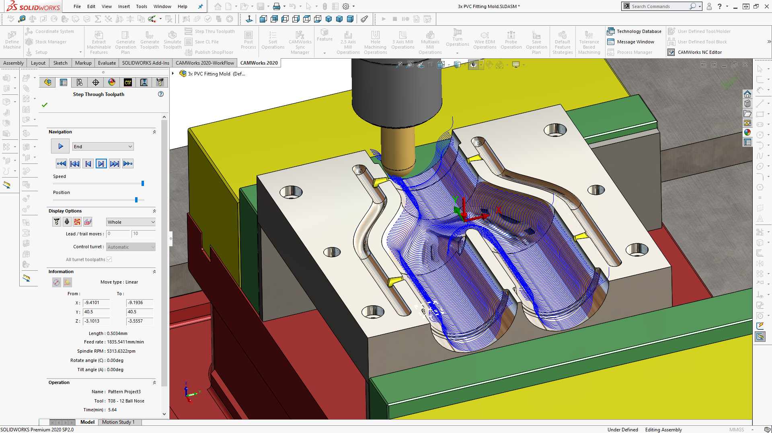
CAM (Computer Aided Manufacturing):
Computer Aided Manufacturing (CAM) is the use of software and computer-controlled machinery to automate a manufacturing process.
It generates toolpaths that guide CNC (Computer Numerical Control) machines to produce precise parts from various materials, including metals, plastics, and composites.
CAD models convert into G – code and M-code these are the machine language .It is used to guide a machine to cutting , drilling, grinding etc.…

Slide 7

INTRODUCTION OF SOLIDWORKS :
Solidworks is a Computer Aided Designing (CAD) Software primarily used for 3D modeling and product designs developed by Dassault system
The first commercial release of SOLIDWORKS was in 1995.The version of 1.0.
It was founded by Jon Hirschtick and was initially developed by SOLIDWORKS Corporation, which later became a part of Dassault Systemes, a multinational software company.
Solidworks is used by engineers, designers, and manufacturers.

Slide 8
Specification of Solidworks :
1.PartDesign
2. Assembly
3. Surface Modeling
Part Design is about building up a part from features which are made from sketches which use constraints.
An assembly is simply a collection of individual parts that have been arranged in such a way that they represent a finished product.
Surface modeling is a mathematical method usually provided in computer-aided design applications for displaying solid-appearing objects
4.Analysis
5. Drafting
Basic analysis often includes visualizing the design and simulating its behavior under specific conditions. This can involve simple animations and simulations.
Drafting refers to the creation of technical drawings and plans using digital tools. Drafting in CAD involves the creation of precise and detailed two-dimensional (2D) or three-dimensional (3D) representations of objects, structures, or designs.

Slide 9
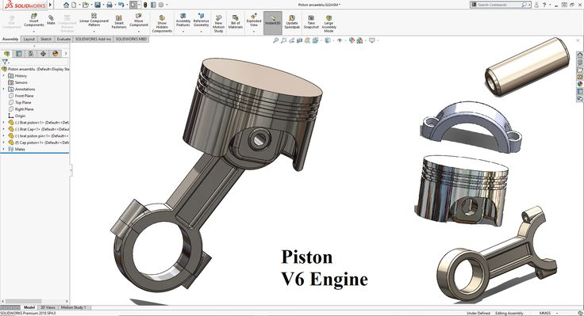
Part Designing :
Part designing is the section where u can design specific components of the machine you are making. For example if you are making an engine, then the piston, connecting rod, screws, etc. are the individual parts that u have to design separately in part designing

Slide 10
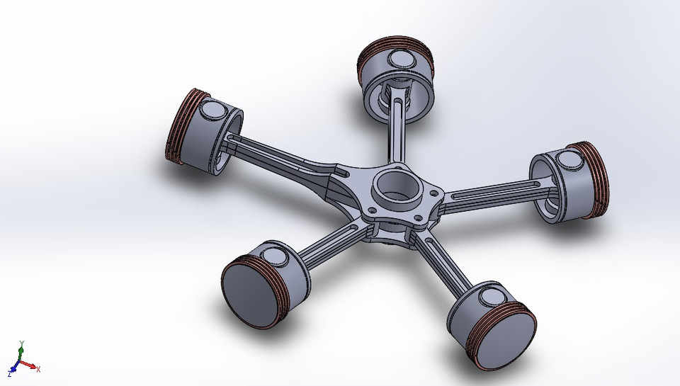
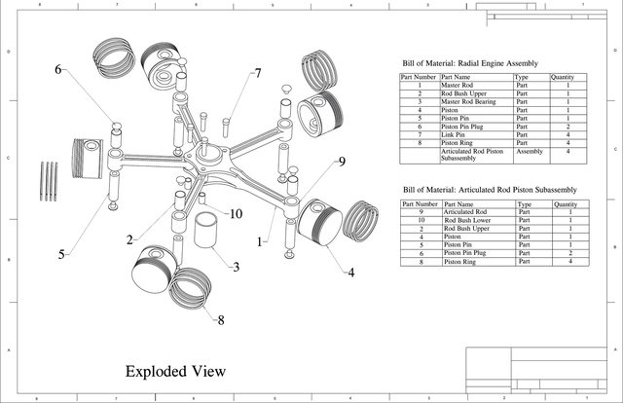
Assembly Designing :
Assembly methods in CAD refer to the techniques and processes used to create and manage assemblies of components and parts within a computer-aided design (CAD) environment.
Constraints and Mates
Degrees of Freedom
Kinematics and Motion Studies
Exploded Views

Slide 11
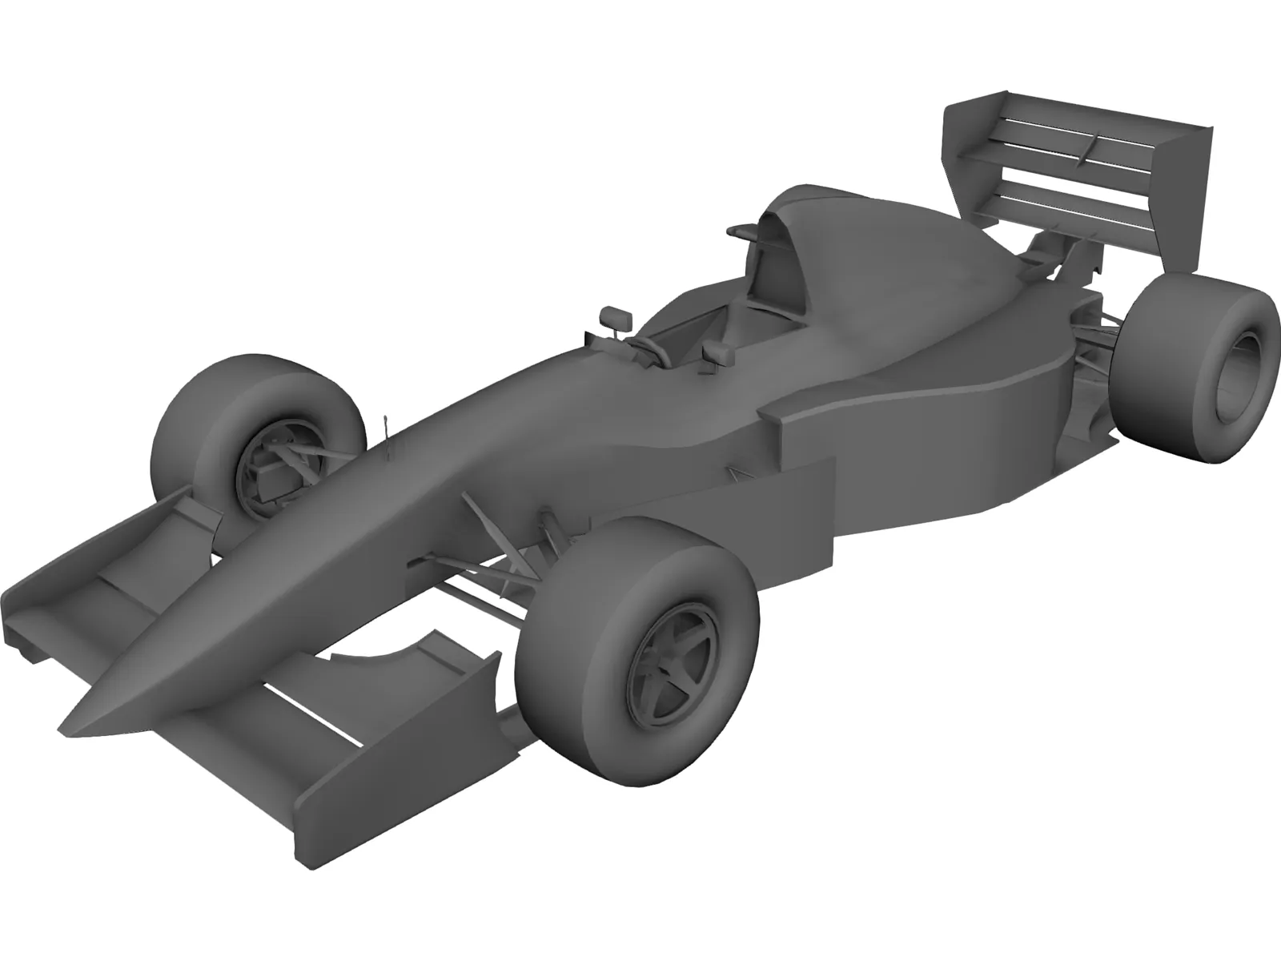
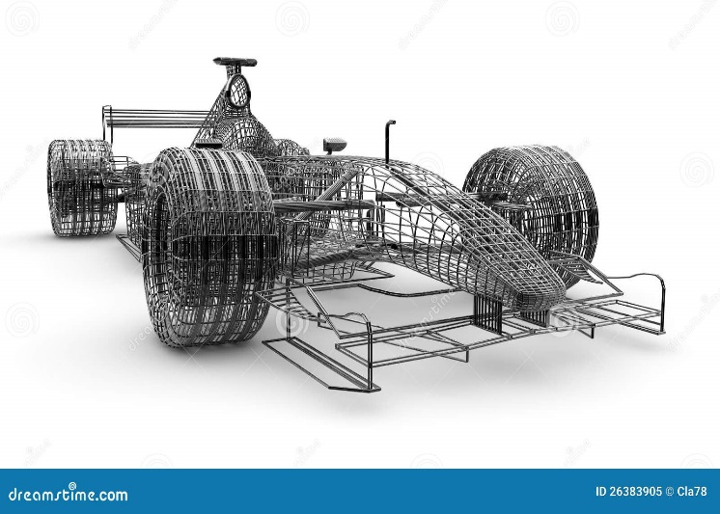
Surface Designing :
Surface modeling in SolidWorks is a powerful technique used to create complex, freeform shapes and surfaces that may not be easily achievable using traditional solid modeling methods.
Free-Form Surface Modeling
Wireframe and Surface Creation

Slide 12
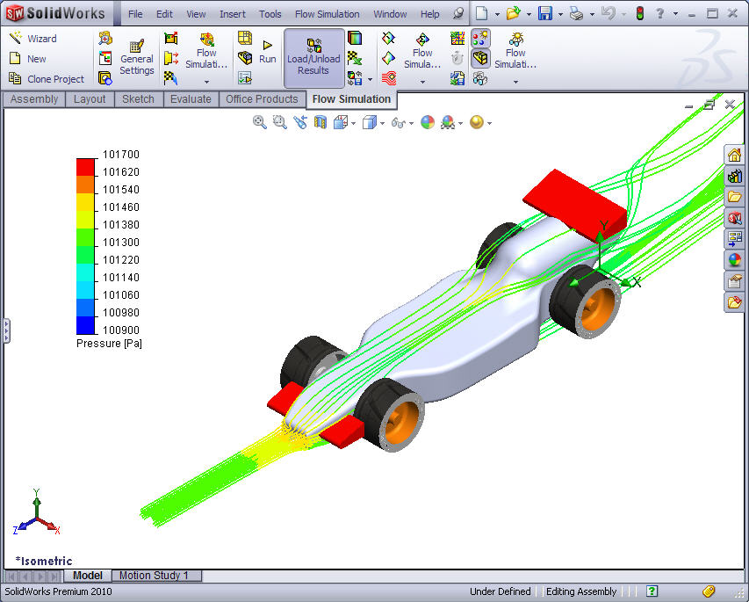
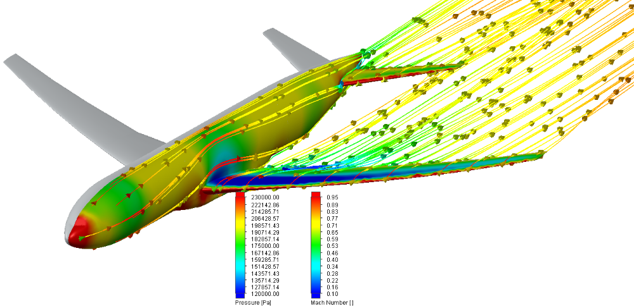
Analysis :
TYPES OF ANALYSIS USED IN CAD SOFTWARE:
Finite Element Analysis (FEA)
Computational Fluid Dynamics (CFD)
Flow Analysis
Thermal Analysis
Motion Analysis
Stress and Strain Analysis

Slide 13
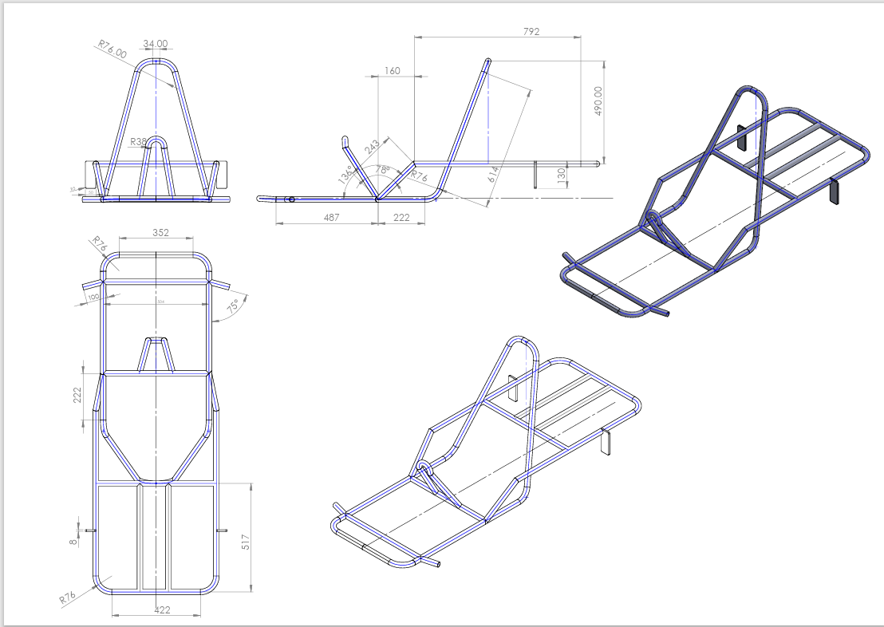
Drafting :
Drafting in CAD (Computer-Aided Design) refers to the process of creating detailed and accurate technical drawings and documentation using digital tools. CAD drafting replaces traditional manual drafting methods, where drawings were created by hand on paper using various drafting instruments.

Slide 14
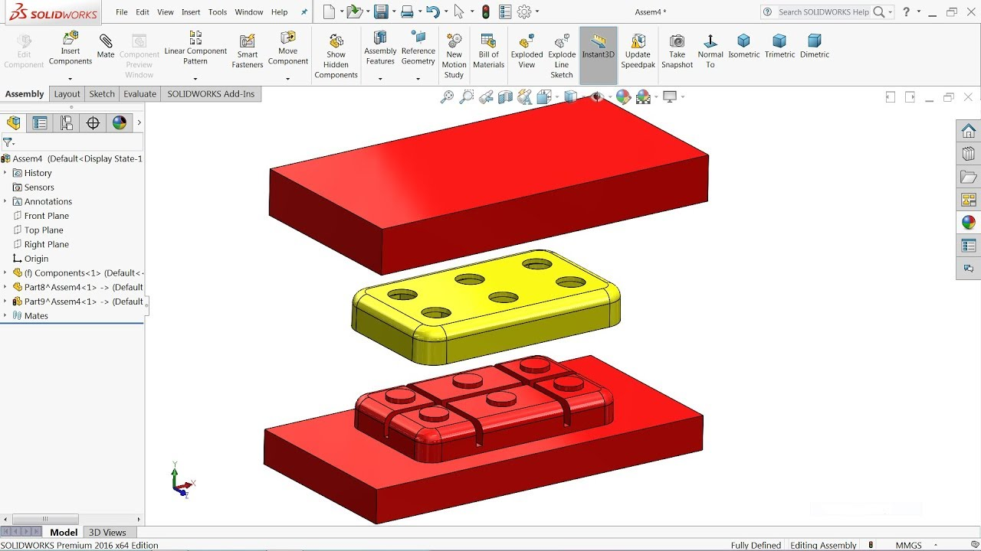
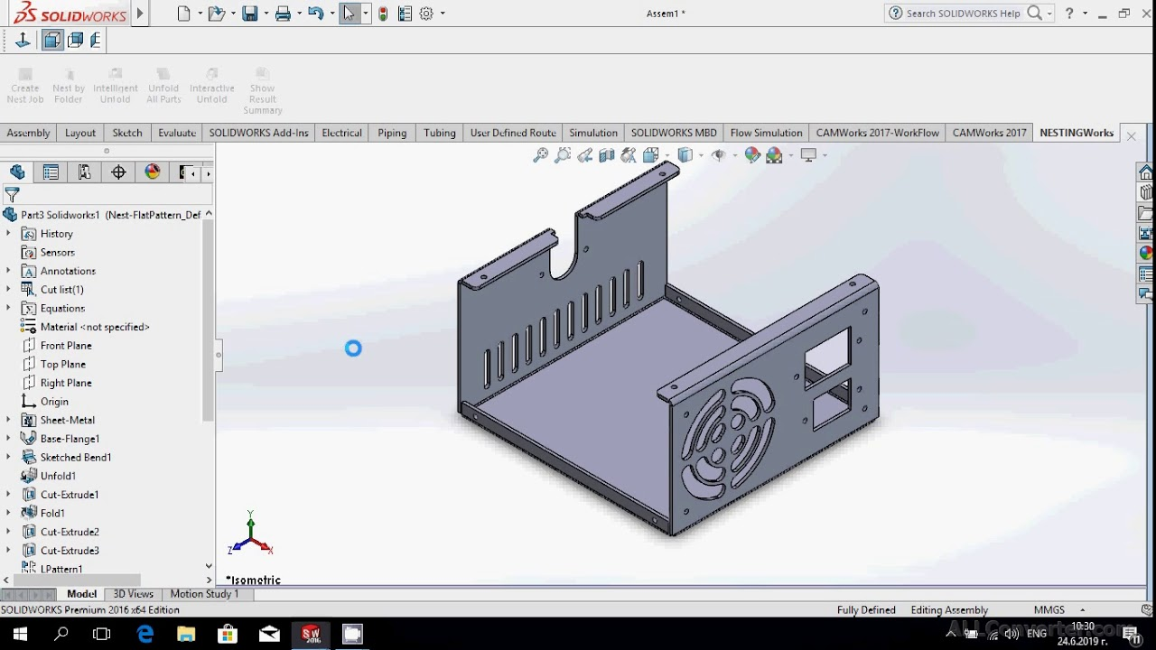
Specialization and Advanced techniques of solidwork:
Aerospace Design and Engineering
Automotive Design
Sheet Metal Design
Weldments Design
Mold and Tooling Design
Simulation and Analysis
Electrical and Electronics Design

Slide 15
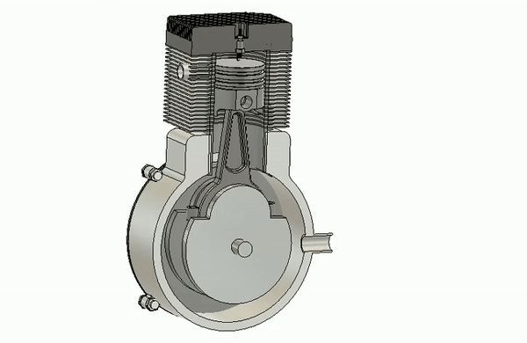
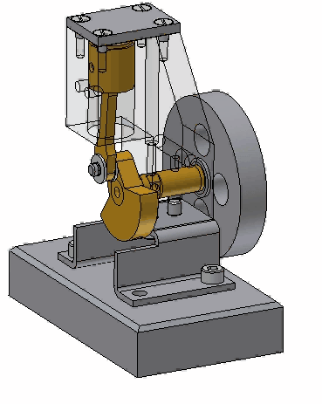
Simulation of engine:
Simulation (SW) used to create virtual representations of objects and their motion . To analyze the working model of a product.
It uses to identifying the ERROR in working mechanism.

Slide 16
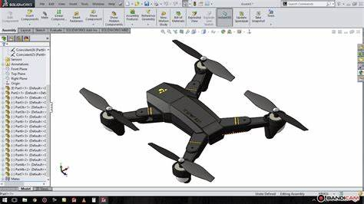

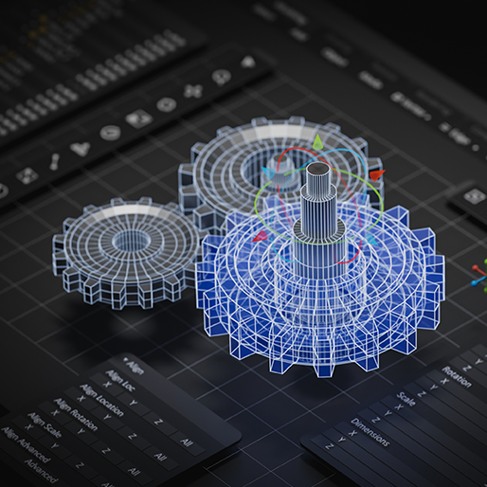
Application of solidwork:
Aerospace engineering
Automotive Engineering
Industrial Machinery Engineering
SolidWorks plays a crucial role in the development of aircraft, satellites, and unmanned aerial vehicles.
SolidWorks enables the development of automotive designs that are safe, efficient, and visually appealing.
SolidWorks is used to design machinery for manufacturing and other industrial applications.

Slide 17





TOP COMPANIES USING SOLIDWORKS :
Tesla - Designing various components of its electric vehicles
Lockheed Martin - SolidWorks for designing complex aerospace and defense systems.
Dell Technologies: - SolidWorks for designing computer hardware and components.
Philips - healthcare, lighting, and consumer products, SolidWorks for designing medical devices and equipment.
Tata Motors: Tata Motors, an Indian automotive manufacturer, has used SolidWorks in its design and engineering work.

Slide 18
TOP SECTORS USING SOLIDWORKS :

Slide 19
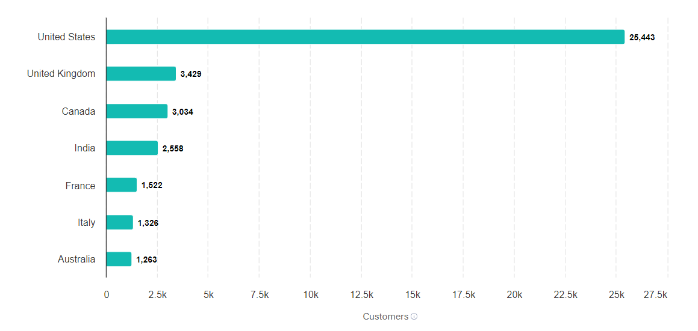
TOP COUNTRIES USING SOLIDWORKS :

Slide 20

Thank You
Contact Info:
+91 994 222 4219
ctggpuram@gmail.com
www.caddtechnologies.com

